Slide 1




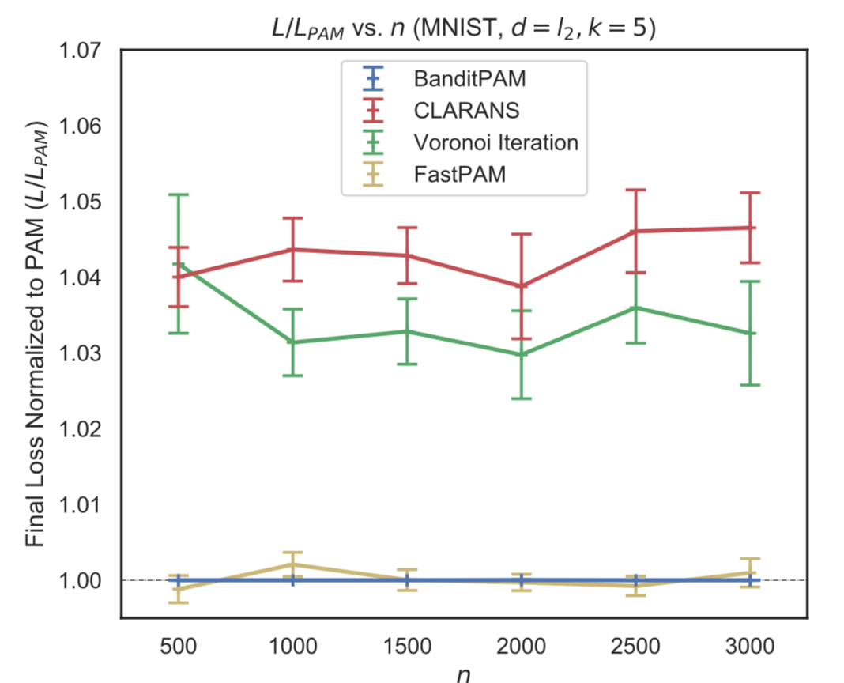
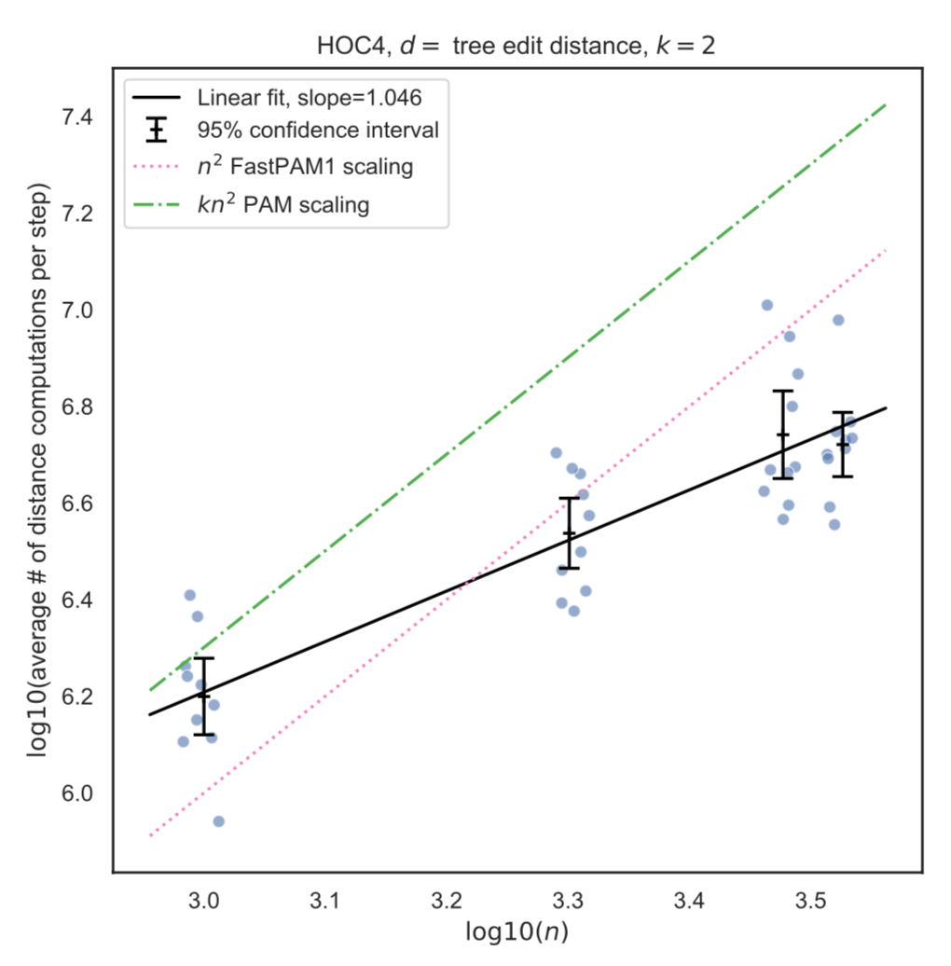
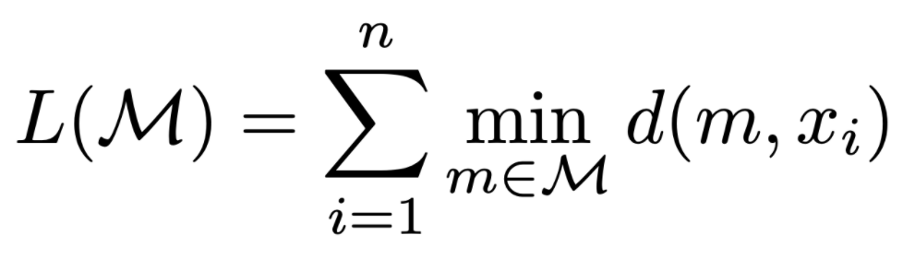
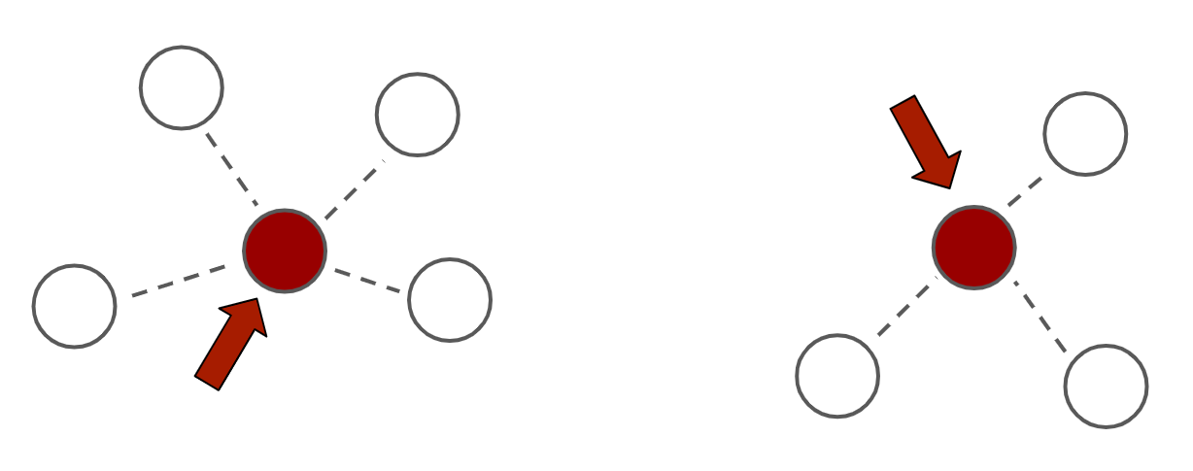
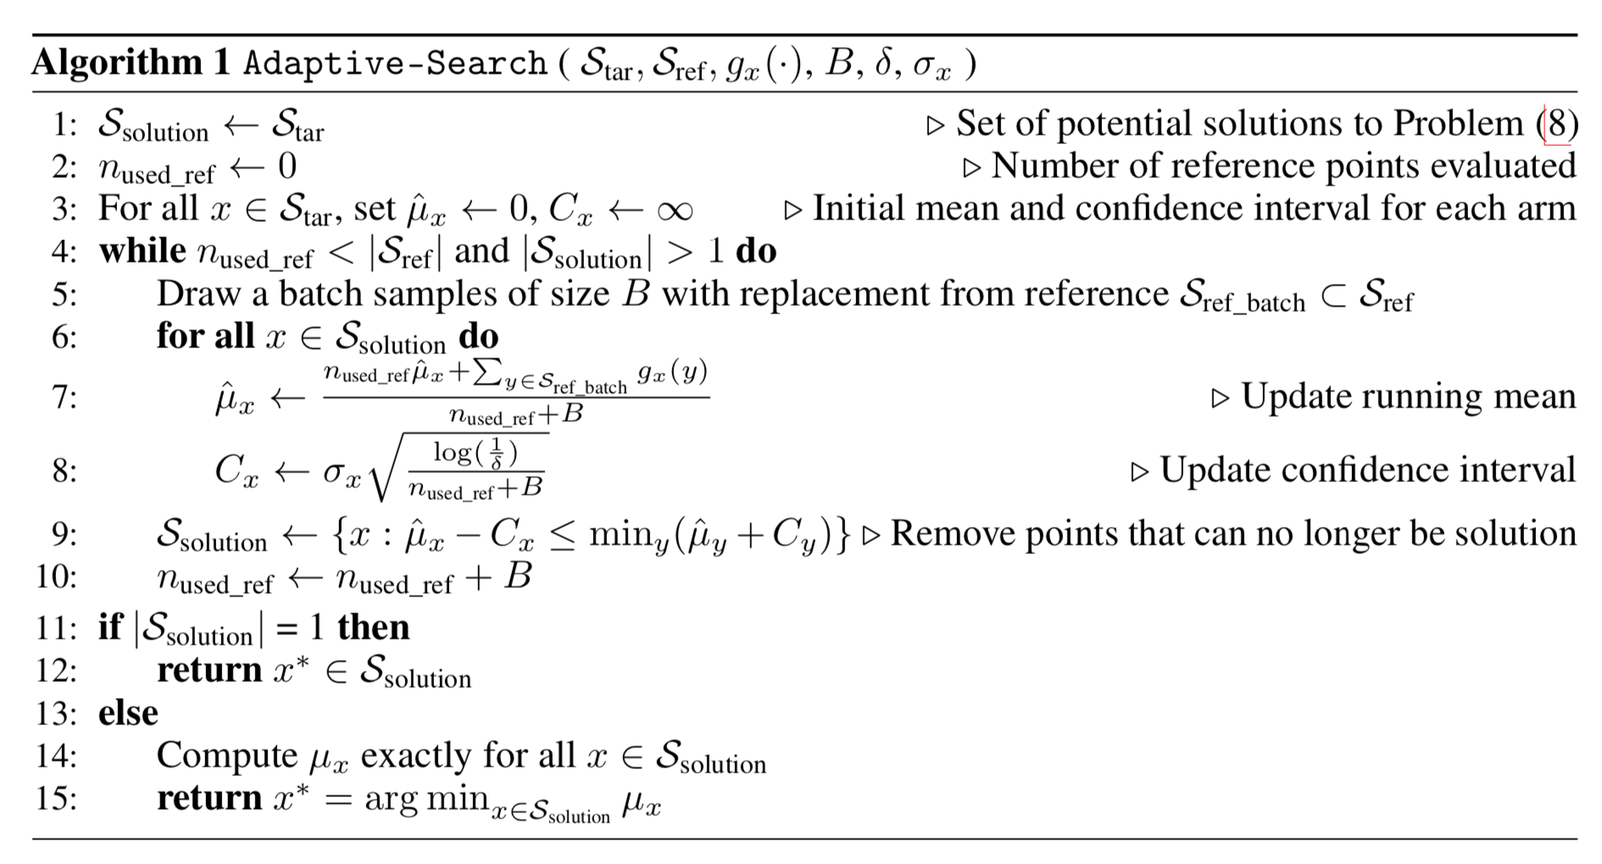
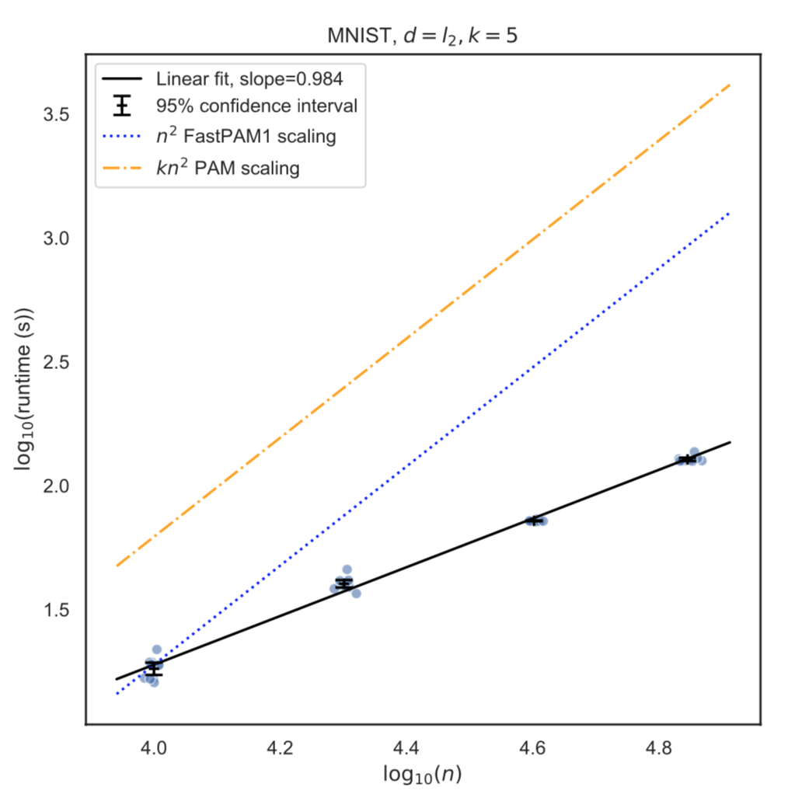
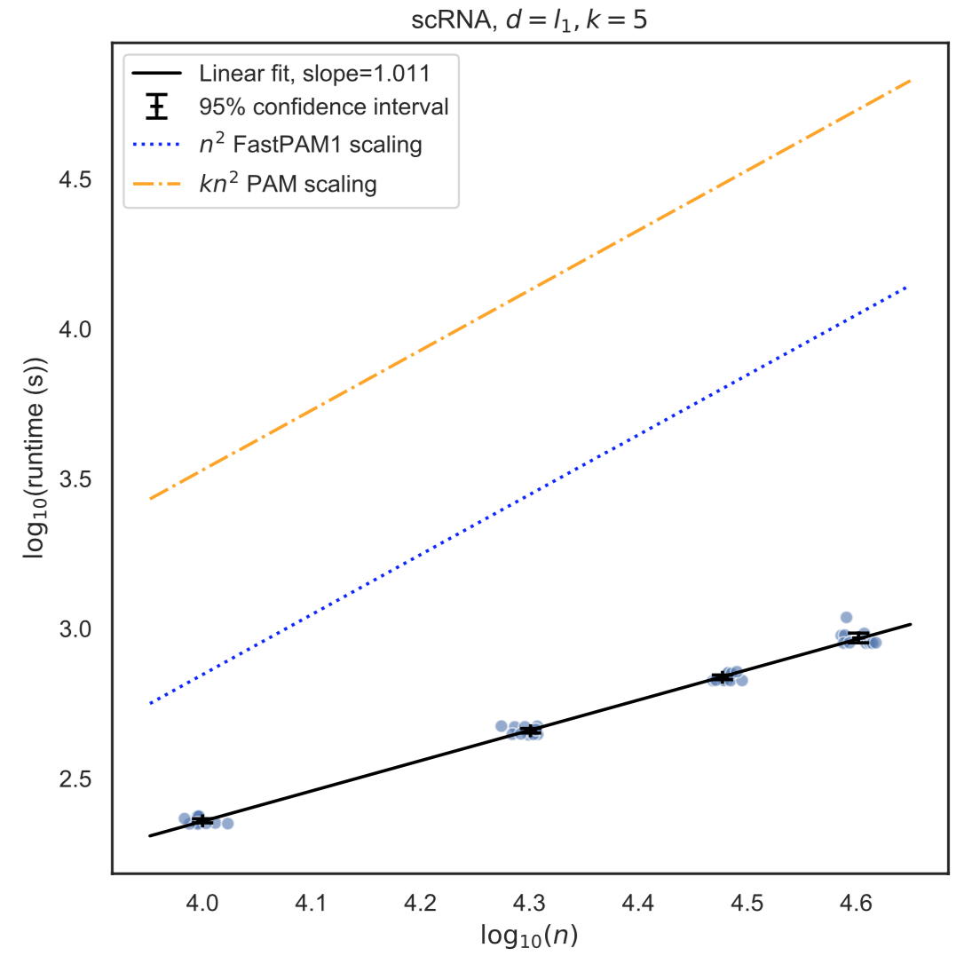
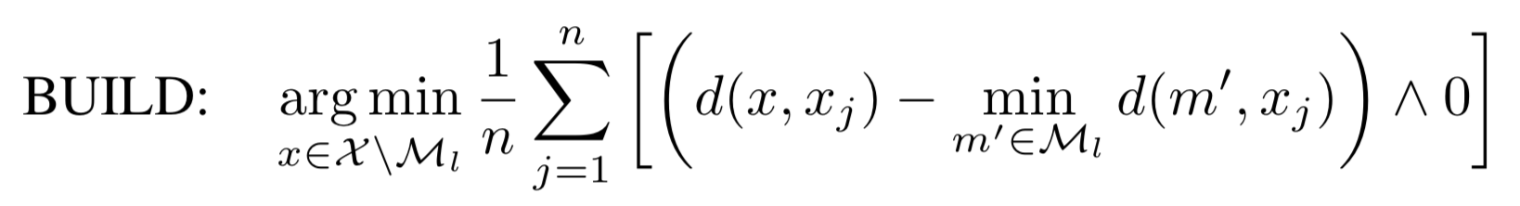
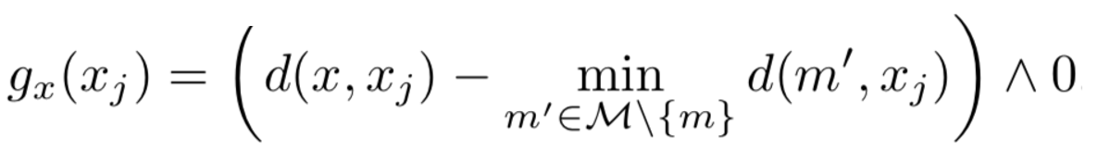
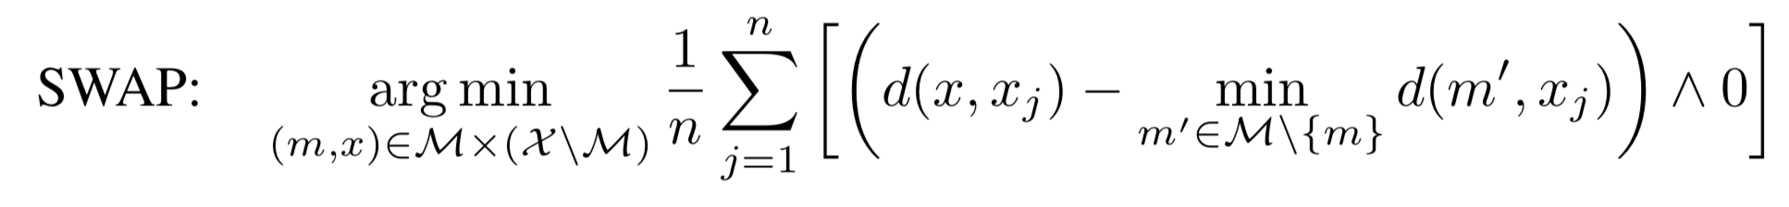


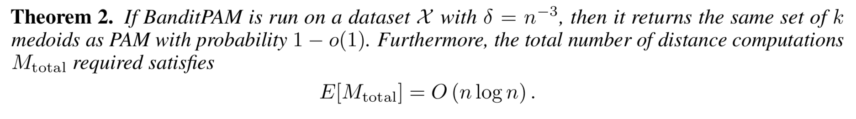

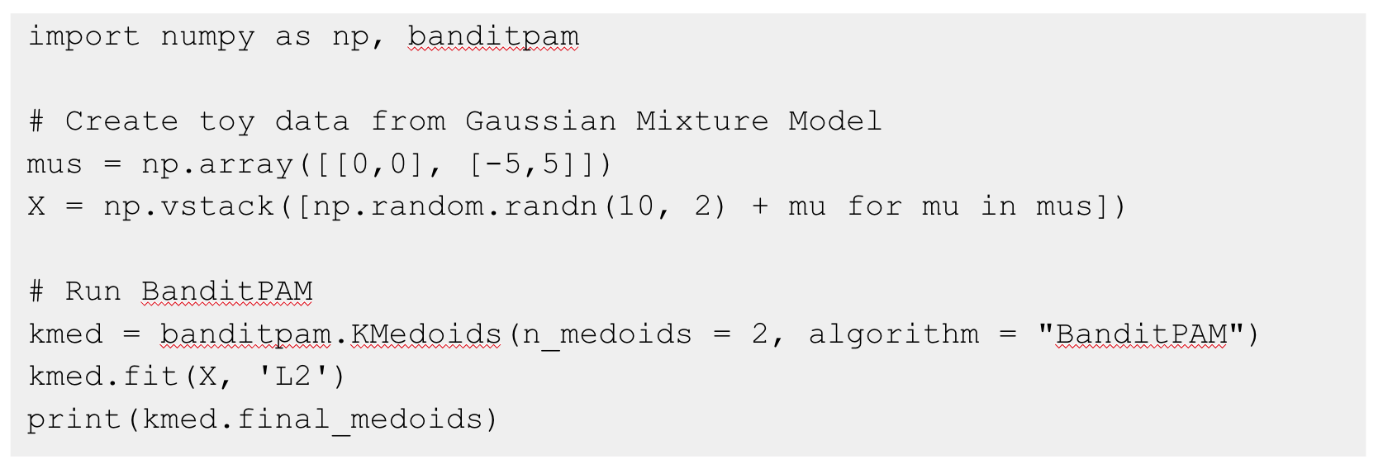


BanditPAM: Almost Linear Time k-medoids Clustering via Multi-Armed Bandits
Introduction: the k-medoids problem
Algorithm: BanditPAM
Experimental Results
The k-medoids problem is a clustering problem, like k-means, in which the objective is to minimize the distance from each point to its nearest cluster center
Unlike k-means, k-medoids requires cluster centers to be actual datapoints:
k-medoids has several advantages over k-means:
- interpretability of the cluster centers (the medoids)
- support for arbitrary distance metrics
BanditPAM each optimization problem as a multi-armed bandit (MAB) problem
In the BUILD step, “arms” correspond to candidate medoids
In the SWAP step, “arms” correspond to (medoid, non-medoid) pairs.
(Left) BanditPAM matches the state-of-the-art clustering quality of PAM in all experiments. (Right) On a dataset of Abstract Syntax Trees with tree edit distance, BanditPAM scales almost linearly in dataset size.
Prior Approaches
Prior state-of-the-art approaches (PAM) work in a two-step process:
1. BUILD: Initialize the medoids one-by-one in a greedy fashion ( denotes min):
2. SWAP: Consider all (medoid, non-medoid) pairs and swap these pairs greedily; iterate until convergence:
Each step is O(n²) since we compute the loss over the entire dataset
Optional section descriptor in 21pt font
is a hyperparameter that governs the probability of error
each is estimated from the data
Contributions
Theoretical Analysis
BanditPAM demonstrates almost linear scaling on the MNIST handwritten digit dataset with L₂ distance (left) and on a single-cell RNA sequencing dataset with L₁ distance (right).
We propose BanditPAM, a new PAM-like algorithm based on multi-armed bandits, which:
- returns the same results as PAM with high probability
- reduces the complexity from O(n²) to O(nlogn)
We also release high-performance Python and C++ packages that enable k-medoids on very large datasets
Python Package
Funding Information
This research was funded in part by JPMorgan Chase & Co. Any views or opinions expressed herein are solely those of the authors listed, and may differ from the views and opinions expressed by JPMorgan Chase \& Co. or its affiliates. This material is not a product of the Research Department of J.P. Morgan Securities LLC. This material should not be construed as an individual recommendation for any particular client and is not intended as a recommendation of particular securities, financial instruments or strategies for a particular client. This material does not constitute a solicitation or offer in any jurisdiction.
M.Z. was also supported by NIH grant R01 MH115676.

